Slide 1
SBIRT Training Screening, Brief Intervention & Referral to Treatment Medication for Addiction Treatment (MAT)
The Faith & Spirituality Integrated SBIRT Network

Slide 2
Navigating the Training
Physician
Pharmacist
Nurse Practitioner
Case Manager
Welcome! These health professionals will guide you through your MAT training.*
Click on the “Previous” and “Next” buttons on the bottom of the page to navigate through the training.
*Note: No audio or interactive animation is available for this training module.

Slide 3
Training Objectives
Hello! Welcome to the training. We will be covering each of these objectives during this module.
Upon completing this training, you will be able to:
Accurately describe the etiology and current trends associated with alcohol and opioid use in the United States.
Accurately identify and describe the different medications for the treatment of alcohol use disorders, opioid use disorders, or both.
Understand the practical considerations when implementing a MAT program.

Slide 4
Defining Substance Use Disorders
Before we begin, let’s define “Substance Use Disorder (SUD)” and explore current trends of alcohol and opioid use.
Substance use disorders are characterized as a chronic, persistent health disease much like diabetes.
Drug interactions cause imbalances and deficits in major brain systems, which underlie continued risk-taking behavior and the development of SUDs.

Slide 5
National Data on Alcohol Use
86% of people ages 18 or older reported that they drank alcohol at some point in their lifetime; 70% reported drinking within the past year; and 56% reported drinking within the past month.
In 2015, 27% of people (18+) reported that they engaged in binge drinking within the past month; 7% reported that they engaged in heavy alcohol use in the past month.
In 2015, 15 million adults (18+) had an alcohol use disorder (9.8 million men and 5.3 million women).
Only about 1.3 million adults received treatment in 2015.
Source: https://pubs.niaaa.nih.gov/publications/alcoholfacts&stats/AlcoholFacts&Stats.pdf

Slide 6
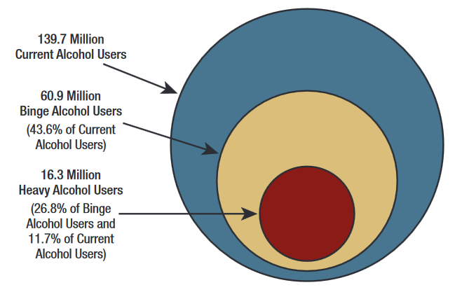
National Data on Alcohol Use
This pie chart depicts the level of current alcohol users, binge, and heavy alcohol use in the U.S.
Current¹, Binge², and Heavy³ Alcohol Use among People Aged 12 or Older: 2014
¹ Current Drinking: any use of alcohol in the past 30 days.
² Binge drinking: drinking 5 or more alcoholic drinks on the same occasion on at least 1 day in the past 30 days.
³ Heavy Drinking: drinking 5 or more drinks on the same occasion on each of 5 or more days in the past 30 days.
Source: NSDUH, 2014
Notes:
http://www.samhsa.gov/data/sites/default/files/NSDUH-FRR1-2014/NSDUH-FRR1-2014.pdf
http://www.niaaa.nih.gov/alcohol-health/overview-alcohol-consumption/moderate-binge-drinking
http://www.samhsa.gov/data/sites/default/files/NSDUH-FRR1-2014/NSDUH-FRR1-2014.pdf

Slide 7
Opioids and the Opioid Epidemic
Opioids are a class of drugs that include the illicit drug heroin, as well as the illicit prescription pain relievers oxycodone, hydrocodone, codeine, morphine, fentanyl, etc.
Opioids are chemically related and interact with opioid receptors on nerve cells in the brain and nervous system to produce pleasurable effects and relieve pain.
Opioid Use Disorders occur when an individual chronically and pathologically pursues the reward/relief provided by substance use and other behaviors, regardless of negative consequences.
Of the 20.5 million Americans who have a substance use disorder, 2 million were involved with prescription pain relievers and 590,000 with heroin.
Source: https://www.asam.org/docs/default-source/advocacy/opioid-addiction-disease-facts-figures.pdf

Slide 8
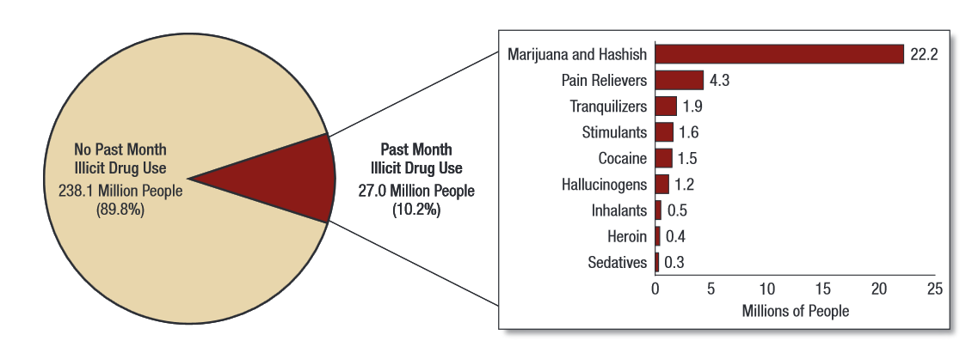
National Data on Drug Use
Numbers of Past Month Illicit Drug Users among People Aged 12 and Older: 2014
Let us look briefly at some national data on drug use.
Source: NSDUH, 2014
Notes:
http://www.samhsa.gov/data/sites/default/files/NSDUH-FRR1-2014/NSDUH-FRR1-2014.pdf

Slide 9
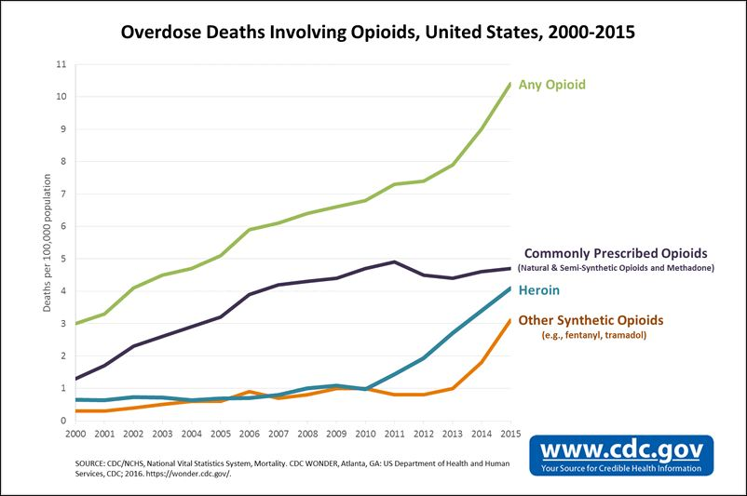
National Data on Opioid Use
Currently, there is an opioid epidemic in the United States. As of 2015, opioid overdose deaths peaked at 22,000.
Source: https://www.cdc.gov/drugoverdose/data/analysis.html
Notes:
Brief: https://www.whitehouse.gov/the-press-office/2015/10/21/fact-sheet-obama-administration-announces-public-and-private-sector
Data: Source: NSDUH, 2014

Slide 10
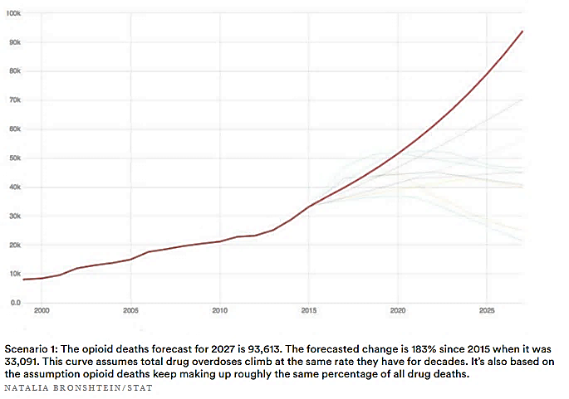
Opioid Overdose Deaths: Worst Case Scenario
If this epidemic goes unaddressed, we may be faced with increasing numbers of opioid overdose deaths, upwards of 93,000 people per year by 2027.

Slide 11
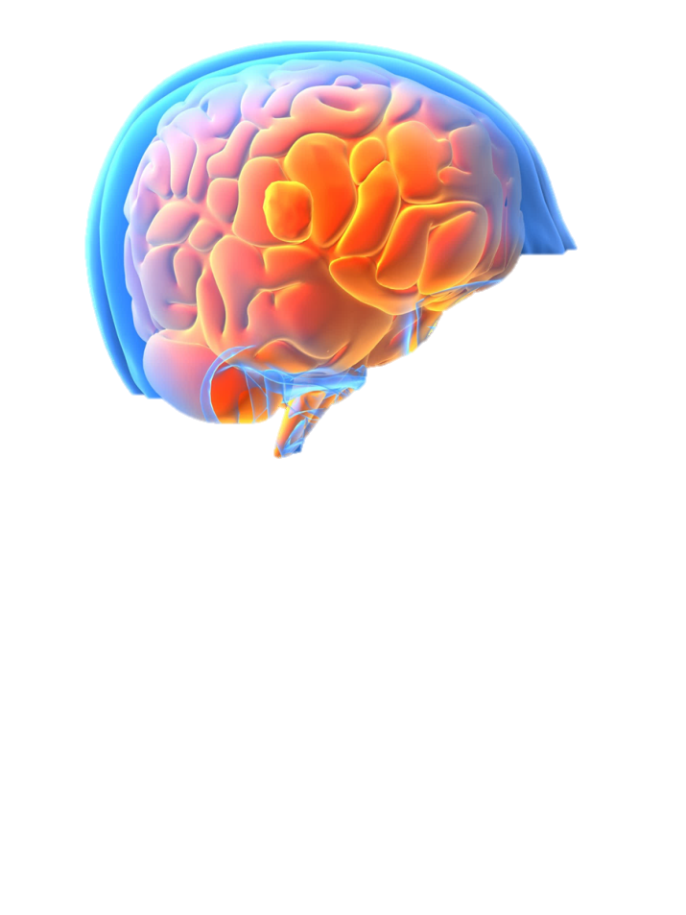
Some people wonder, “Why can’t people just stop using drugs?”
Prolonged drug use changes the brain in fundamental and long-lasting ways.
Neuroscience, cognitive, and behavioral research has confirmed that substance use disorders are brain disorders that develop over time.

Slide 12
The Science of Substance Use Disorders
Watch this video to see how substance use can impact the reward circuit.
Notes:
https://youtu.be/DMcmrP-BWGk

Slide 13
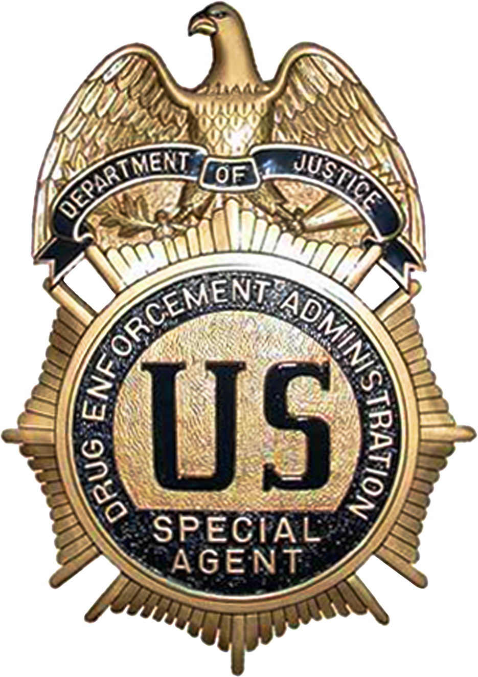
What is Medication Assisted Treatment (MAT)?
Drugs are substances that change the body’s functioning. Medications are drugs that restore normal functioning.
MAT is the use of FDA-approved medications, in combination with counseling, to provide a whole-person approach to the treatment of SUDs.
MAT is clinically driven and focuses on individualized client care.
Research shows that the combination of medication and behavioral therapies works best to treat substance use disorders.

Slide 14
Benefits of Medication for Addiction Treatment (MAT)
SUDs are complex and difficult to treat; we need to use all available to tools to maximize positive patient outcomes.
MAT takes a biopsychosocial approach by combining medication with counseling.
MAT is a safe and effective approach to treat opioid and alcohol use disorders.
Research shows that MAT improves treatment retention.
Research also shows that MAT supports improved functioning across several psychosocial parameters.
MAT is evidence-based – it works!

Slide 15
Video: Medication-Assisted Treatment Works

Slide 16
Types of FDA Approved Medications
Notice that Naltrexone can be used for both alcohol and opioids.
Medications for Alcohol Use Disorder
Medications for Opioid Use Disorder
Disulfiram
Naltrexone
Acamprosate
Methadone
Naltrexone
Buprenorphine
Notes:
[Note for Michael]: Students will be able to click on any substance and pull up more information.

Slide 17
How Can We Treat Alcohol Use Disorder?
Let’s start by looking at MAT for alcohol use. In the next few slides, we’ll go over each of the medications.
Medications for Alcohol Use Disorder can:
Reduce withdrawal symptoms
Block or ease euphoria from alcohol
Discourage drinking by creating an unpleasant association with alcohol
Notes:
These medications can help to reduce the agitation associated with post acute withdrawal, block the pleasurable effects of alcohol, or discourage drinking by making the making the person sick if they drink.
17

Slide 18
Disulfiram
Alcohol
Disulfiram is commonly known as Antabuse®
Discourages drinking by making the patient physically sick when alcohol is consumed.
Non-addictive and no reports of misuse.
Research shows that participants treated with disulfiram drank alcohol on fewer days than those treated with placebo.
Notes:
18
It was approved by the FDA in 1951. It works by maintaining a state of enforced sobriety. It does this by making the individual sick of they consume alcohol. Disulfiram has no known addictive properties and there have been no reports of misuse.

Slide 19
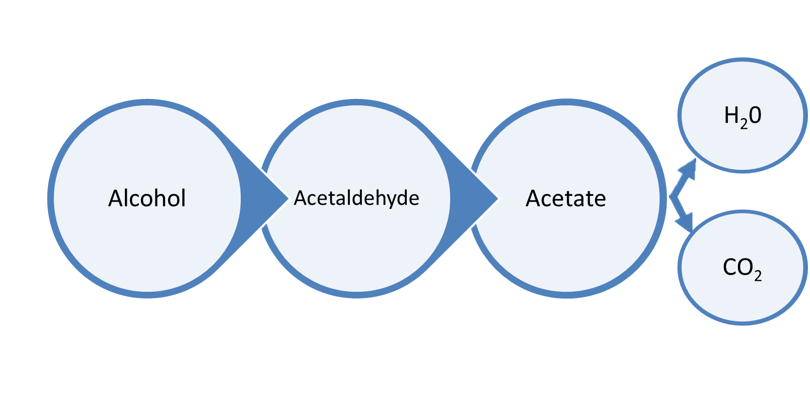
Alcohol
How Does Disulfiram Work?
Alcohol Dehydrogenase
Acetaldehyde Dehydrogenase
Disulfiram works by blocking the enzyme acetaldehyde dehydrogenase. This causes acetaldehyde to accumulate in the blood at 5 to 10 times higher than what would normally occur with alcohol alone.
Notes:
19
When an individual drinks alcohol, it is broken down in three stages. First, the enzyme Alcohol Dehydrogenase converts alcohol into Acetaldehyde. Acetaldehyde is actually a toxic compound and therefore must be broken down further and eliminated.
This occurs through the enzyme Acetaldehyde Dehydrogenase. It converts that acetaldehyde into acetate. Finally, Acetate is converted into water and carbon dioxide and eliminated from the body.
Disulfiram works by blocking the effect of acetaldehyde dehodrogenase. This causes a build of up the toxic acetaldehyde to levels 5-10 times greater than would normally occur of alcohol was breaking down normally.

Slide 20
Symptoms of Disulfiram
Alcohol
Throbbing in Head/Neck
Brief Loss of Consciousness
Throbbing Headache
Lowered Blood Pressure
Difficulty Breathing
Uneasiness
Vomiting
Nausea
Flushing
Sweating
Thirst
Weakness
Chest Pain
Dizziness
Palpitation
Hyperventilation
Rapid Heartbeat
Blurred Vision
Confusion
Respiratory Depression
Cardiovascular Collapse
Myocardial Infarction
Congestive Heart Failure
Unconsciousness
Convulsions
Death
Since acetaldehyde is poisonous, a buildup of it produces highly unpleasant symptoms, commonly referred to as the “disulfiram-alcohol reaction.”
Notes:
20
This buildup leads to extremely unpleasant symptoms known as the disulfiram-alcohol reaction. Take a look at this list of symptoms.
(1)
In severe forms, the disulfiram-alcohol reaction can be very serious leading to respiratory suppression, heart attack, convulsions and even death.

Slide 21
Important Considerations of Disulfiram
Alcohol
As long as there is alcohol in the blood, the disulfiram-alcohol reaction will continue.
The disulfiram-alcohol reaction usually lasts for 30 to 60 minutes, but can continue for several hours depending on the amount of alcohol consumed.
The disulfiram-alcohol reaction can be triggered when alcohol is consumed one or two weeks after the last dose of disulfiram.
Disulfiram should not be administered to someone who has consumed alcohol-containing preparations such as cough syrup, tonics, etc.
Notes:
(1) It’s important to not that this reaction will continue for as long as there is alcohol remaining in the blood.
(2) The symptoms can occur in some very sensitive patients even with extremely low concentrations of alcohol
(3) The reaction will also continue for 1-2 weeks following the last dos of disulfiram.

Slide 22
Acamprosate Calcium
Alcohol
Acamprosate is commonly known as Campral®
Helps maintain abstinence from alcohol in patients with alcohol dependence by reducing withdrawal symptoms.
Non-addictive and no reports of misuse.
Research shows that participants treated with acamprosate drank alcohol on fewer days than those treated with placebo.
Research also shows that those treated with acamprosate were able to regain abstinence after one relapse more frequently than those treated with placebo.
Notes:
It was approved in 2004 for the maintenance of abstinence by reducing post acute withdrawal symptoms. It has no known addictive properties

Slide 23
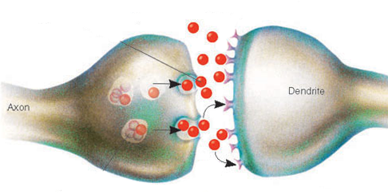
How Does Acamprosate Work?
Alcohol
Acamprosate is a glutamate receptor modulator. In order to counteract alcohol’s depressive effects, the brain responds to repetitive consumption of alcohol by increasing the number of glutamate receptors.
Acamprosate is thought to reduce the amount of glutamate released, and reduce the activity of the glutamate receptors.
Post-Synaptic Neuron
Pre-Synaptic Neuron
NMDA
Receptors
= Glutamate
= Acamprosate
Notes:
23
Acamprosate is thought to inhibit glutamate overactivity, both by reducing the release of glutamate from the presynaptic nerve terminal, and by reducing the overactivation of glutamate receptors postsynaptically
Acamprosate “cushions” the brain against the stimuli and symptoms that often lead to relapse. In an individual who is committed to abstinence this can make the difference between success and failure in avoiding relapse

Slide 24
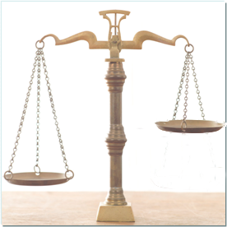
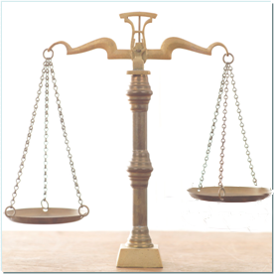
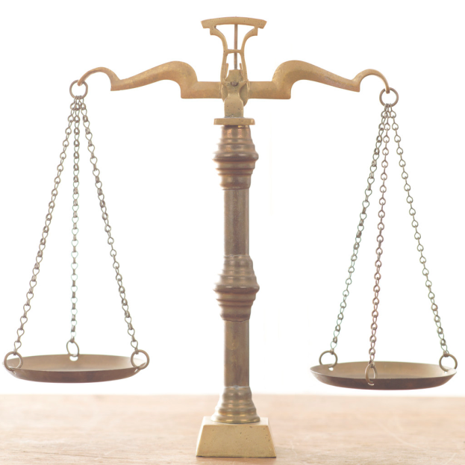
How Does Acamprosate Work?
Alcohol
Withdrawal
Post Acute Withdrawal
Normal
A
GABA
Glutamate
GABA
Glutamate
GABA
Glutamate
After one stops consuming alcohol, the glutamate system continues to be overactive as it readjusts by down regulating the glutamate receptors.
During this time, the individual continues to feel anxiety and agitation that can lead to relapse. Acamprosate helps to reregulate the glutamate system.
Notes:
24
After the acute withdrawal is resolved,
(1) it takes time for the glutamate to return to normal levels. During that time, the individual continues to feel anxious and agitated. This is a frequent source of relapse for individuals.
(2) Acamprosate helps to dampen the effects of glutamate and to help the individual feel more normal.

Slide 25
Naltrexone Hydrocholoride
Alcohol & Opioid
Naltrexone is commonly known as ReVia® and Depade®
Is a full mu opioid antagonist.
Used to treat alcohol or opioid dependence by blocking the effects of opioids thereby decreasing the pleasurable effects of alcohol or opioids.
Available in oral/pill or long-acting injectable formulations.
Research shows that participants treated with naltrexone drank alcohol on fewer days than those treated with placebo.
Research shows naltrexone reduces opioid use, and also reduces risk of re-imprisonment for justice-involved patients.
Notes:
It is approved for the treatment of alcohol or opioid dependence and works by blocking the effects of opioids and reducing the pleasurable effects of alcohol. It has no known addictive properties, but should only be administered to individuals who are abstinent from opioids.

Slide 26
Extended-Release Naltrexone (Vivitrol®)
Alcohol & Opioid
Blocks opioid receptors for one entire month compared to approximately 28 doses of oral naltrexone.
Must be administered by a healthcare professional and should alternate buttocks each month.
It is not possible to remove it from the body once extended-release naltrexone has been injected.
When compared to placebo, those receiving extended release naltrexone for 6 months had fewer opioid positive urines, retained in treatment longer, had fewer cravings, and showed greater improvement quality of life and overall health status
Notes:
26
Dosing with extended release naltrexone required one injection once per month. The medication the blocks the opioid receptors for 4 weeks—this would require 28 doses of oral naltrexon.
Once it is in, there is no way to remove it. Therefore, the person is prevented from experiencing the effects of opioids and/or alcohol

Slide 27
How Can We Treat Opioid Use Disorders?
That concludes the medications for alcohol. In the next few slides, we’ll go over each of the medications for treating opioid use.
Opioid Use Disorders are treated most successfully by a combination of pharmacological and counseling interventions.
Medications for Opioid Use Disorder can:
Alleviate withdrawal & craving
Block euphoria from opioids
Notes:
These medications can help to reduce the agitation associated with post acute withdrawal, block the pleasurable effects of alcohol, or discourage drinking by making the making the person sick if they drink.
27

Slide 28
Methadone
Opioid
Methadone is commonly known as Methadose® and Dolophine®
Is commonly used for opioid use disorders.
Is a full mu opioid agonist. It binds to the same receptor sites as other opioids and alleviates withdrawal and blocks euphoria.
Suppresses withdrawal and craving for 24 hours.
Shown to be safe and effective when used appropriately and in combination with psychosocial services.
Notes:
Kreek MJ, (1992). Rationale for maintenance pharmacotherapy of opiate dependence. Research publications - Association for Research in Nervous and Mental Disease, 70, 205-230.

Slide 29
Benefits of Methadone Maintenance
Opioid
Suppresses opioid withdrawal and reduces craving.
Has few long-term side-effects.
Research has found that it…
Reduces death rates by 8-10 fold.
Reduces drug use.
Reduces criminal activity associated with drug use.
Promotes engagement in socially productive roles and improves family and social functioning.
Helps to increase employment.
Improves physical and mental health.
Reduces the spread of HIV and other infectious diseases by reducing the use of needles.
Notes:
There are a few long-term health effects from use of methadone. Those known include:
weight gain, possibly influenced by fluid retention and dietary changes
reduced production of saliva – may contribute to dental problems
endocrine changes – may result in impotence, low libido, disrupted menstrual cycle
may be harmful in presence of underlying disease; e.g. kidney or liver problems
some effects disappear when dose is adjusted.

Slide 30
Opioid
This graph demonstrates the effectiveness of Methadone in reducing death rates among heroin users.
Notes:
Methadone maintenance has been shown to reduce death rates by factors ranging from three fold to sixty-three fold. (1, 2, 3, 4, 5, 6)
In one study, heroin addicts enrolled in methadone treatment were one-quarter as likely to die by heroin overdose or suicide as were heroin addicts not in methadone treatment. This study followed 296 heroin addicts for more than 15 years. In another study, a group of heroin addicts were followed over twenty years. One-third died within that time. Of the survivors, 48% were enrolled in a methadone program for treatment. The authors of the study concluded that heroin addiction is a chronic disease with a high fatality rate, and that methadone maintenance offered a significant benefit.
We suspect, but don’t know for sure, that pain pill addicts will have similar rates of death, since both groups are addicted to opioids. Studies are being done now, following pain pill addicts to see if their outcome will be similar to heroin addicts.
The young addicts of Eastern Tennessee are paying a heavy price for the denial of local officials.
Caplehorn JR, Dalton MS, et. al., Methadone maintenance and addicts’ risk of fatal heroin overdose. Substance Use and Misuse, 1996 Jan, 31(2):177-196. In this study of heroin addicts, the addicts in methadone treatment were one-quarter as likely to die by heroin overdose or suicide. This study followed two hundred and ninety-six methadone heroin addicts for more than fifteen years.
Clausen T, Waal H, Thoresen M, Gossop M; Mortality among opiate users: opioid maintenance therapy, age and causes of death. Addiction 2009; 104(8) 1356-62. This study looked at the causes of death for opioid addicts admitted to opioid maintenance therapy in Norway from 1997-2003. The authors found high rates of overdose deaths both prior to admission and after leaving treatment. Older patients retained in treatment died from medical reasons, other than overdose.
Goldstein A, Herrera J, Heroin addicts and methadone treatment in Albuquerque: a year follow-up. Drug and Alcohol Dependence 1995 Dec; 40 (2): p. 139-150. A group of heroin addicts were followed over twenty years. One-third died within that time, and of the survivors, 48% were on a methadone maintenance program. The author concluded that heroin addiction is a chronic disease with a high fatality rate, and methadone maintenance offered a significant benefit.
Gronbladh L, Ohlund LS, Gunne LM, Mortality in heroin addiction: Impact of methadone treatment, Acta Psychiatrica Scandinavica Volume 82 (3) p. 223-227. Treatment of heroin addicts with methadone maintenance resulted in a significant drop in mortality, compared to untreated heroin addicts. Untreated addicts had a death rate 63 times expected for their age and gender; heroin addicts maintained on methadone had a death rate of 8 times expected, and most of that mortality was from diseases acquired prior to treatment with methadone.
Scherbaum N, Specka M, et.al., Does maintenance treatment reduce the mortality rate of opioid addicts? Fortschr Neurol Psychiatr, 2002, 70(9):455-461. Opioid addicts in continuous treatment with methadone had a much lower mortality rate (1.6% per year) than opioid addicts who left treatment (8.1% per year).
Zanis D, Woody G; One-year mortality rates following methadone treatment discharge.Drug and Alcohol Dependence, 1998: vol.52 (3) 257-260. Five hundred and seven patients in a methadone maintenance program were followed for one year. In that time, 110 patients were discharged and were not in treatment anywhere. Of these patients, 8.2% were dead, mostly from heroin overdose. Of the patients retained in treatment, only 1% died. The authors conclude that even if patients enrolled in methadone maintenance treatment have a less-than-desired response to treatment, given the high death rate for heroin addicts not in treatment, these addicts should not be kicked out of the methadone clinic.

Slide 31
Buprenorphine
Opioid
Buprenorphine is commonly known as Subutex®
May be used both for medical maintenance pharmacotherapy and for medically supervised withdrawal.
Is generally safe and well tolerated when used as recommended.
Can precipitate opioid-like withdrawal symptoms in patients with high levels of physical dependence.
Is as effective as moderate doses of methadone.
Has over 25 years of research supporting its use.

Slide 32
How Does Buprenorphine Work?
Opioid
It is a Partial Opioid Agonist. It binds to the same receptor sites as other opioids and alleviates withdrawal and blocks euphoria.
Binds strongly to opiate receptor and is long-acting.
It produces a ceiling effect that prevents larger doses from producing greater agonist effects, although larger doses lengthen its duration of activity.
It is a available in the form of pills or film/sublingual formulations.
It is available for use in office-based settings, and designed for take-home dosing. This makes it a more flexible treatment than methadone.
Notes:
32

Slide 33
Implementing Medication-Assisted Treatment
There are many different, empirically tested models of MAT delivery.
MAT Implementation Procedures include:
A complete, thorough assessment to determine appropriateness of MAT.
Developing a plan and overseeing provisions of MAT services in accordance with best practices.
Ensuring the appropriate medical providers are integrated into the treatment team.
Regular and ongoing assessment should be conducted to ensure the continued appropriateness of care throughout the intervention.

Slide 34
Challenges for MAT
Like all medications, MAT will only work if the patient is diligent about taking it orally or coming into the clinic for routine injections.
Since MAT is fairly new, the long-term impact is not yet fully known.
There may be some stigma surrounding MAT among those in recovery and treatment providers.
Certain treatment centers uphold a policy of sobriety and do not recognize use of MAT.
Those in recovery who did not utilize MAT may hold certain beliefs about the use of medication for recovery.

Slide 35
Module Review
Let’s review what we’ve learned!
Addiction is a brain disease and should be treated like other physical diseases and disorders.
Medications used to treat Alcohol Use Disorder include Disulfiram, Acamprosate, and Naltrexone.
Medications used to treat Opioid Use Disorder include Methadone, Buprenorphine, and Naltrexone.
MAT should be used in combination with counseling/therapy and other medical healthcare.
MAT implementation involves assessment and developing a plan, having qualified medical providers, and an ongoing evaluation of treatment.

Slide 36
Module Quiz
Answer the following questions to test your knowledge. Please write down your answers.
The “disulfiram-alcohol reaction” refers to the buildup of acetaldehyde, which is poisonous and causes the individual to experience unpleasant symptoms when they consume alcohol.
□ True □ False
Naltrexone can be used to treat both alcohol and opioid use disorders.
□ True □ False
Which of the following is the most effective way of treating a SUD?
A. Outpatient treatment centers that offer therapy are the best way to treat SUDs.
B. Medication for Addiction Therapy is the most effective way of treating an SUD, even without the help of therapy.
C. The combination of MAT and behavioral therapy is the most effective way of treating SUDs.
4. Which of the following medications are used to treat opioid use disorders?
A. Methadone and Disulfiram
B. Buprenorphine and Methadone
C. Acamprosate and Disulfiram
Notes:
Answer Key:
T
F
F
T
T

Slide 37
Module Quiz: Check Your Answers
Here are the answers. How well did you do?
The “disulfiram-alcohol reaction” refers to the buildup of acetaldehyde, which is poisonous and causes the individual to experience unpleasant symptoms when they consume alcohol.
□ True
Naltrexone can be used to treat both alcohol and opioid use disorders.
□ True
Which of the following is the most effective way of treating a SUD?
C. The combination of MAT and behavioral therapy is the most effective way of treating SUDs.
4. Which of the following medications are used to treat opioid use disorders?
B. Buprenorphine and Methadone
Notes:
Answer Key:
T
F
F
T
T

Slide 38
Resources for MAT
That’s it for the training! Here are some helpful resources for you on MAT. You can also download the MATx mobile app found on the SAMHSA website!
SAMHSA MAT: https://www.samhsa.gov/medication-assisted-treatment
Opioid Treatment Program Locator: http://dpt2.samhsa.gov/treatment/directory.aspx
Medication-Assisted Treatment for Opioids: Facts for Families and Friends: https://store.samhsa.gov/shin/content/SMA09-4443/SMA09-4443.pdf
TIP 43: Medication-Assisted Treatment for Opioid Addiction in Opioid Treatment Programs: https://store.samhsa.gov/shin/content//SMA12-4214/SMA12-4214.pdf
Increase Limit Rule to 275 Patients for Physicians: http://buprenorphine.samhsa.gov/forms/select-practitioner-type.php
Buprenorphine Practitioner Verification for Pharmacists: https://www.samhsa.gov/bupe/lookup-form
Policies Surrounding MAT:
Drug Addiction Treatment Act (DATA) 2000: https://www.deadiversion.usdoj.gov/pubs/docs/dwp_buprenorphine.htm
Comprehensive Addiction Recovery Act (CARA): https://www.congress.gov/bill/114th-congress/senate-bill/524
Legislation, Regulations, and Guidelines: https://www.samhsa.gov/medication-assisted-treatment/legislation-regulations-guidelines

